Slide 1
Mall Customer Segmentation
Zaki

Slide 2
Contents
Introduction to Mall Customer Segmentation Project
Exploratory data analysis
Modelling using K- means
Conclusions

Slide 3
Problem Statement
Solution
You are owing a supermarket mall and through membership cards , you have some basic data about your customers like Customer ID, age, gender, annual income and spending score.
Identify Target Customers so that marketing team can plan campaigns around them.

Slide 4
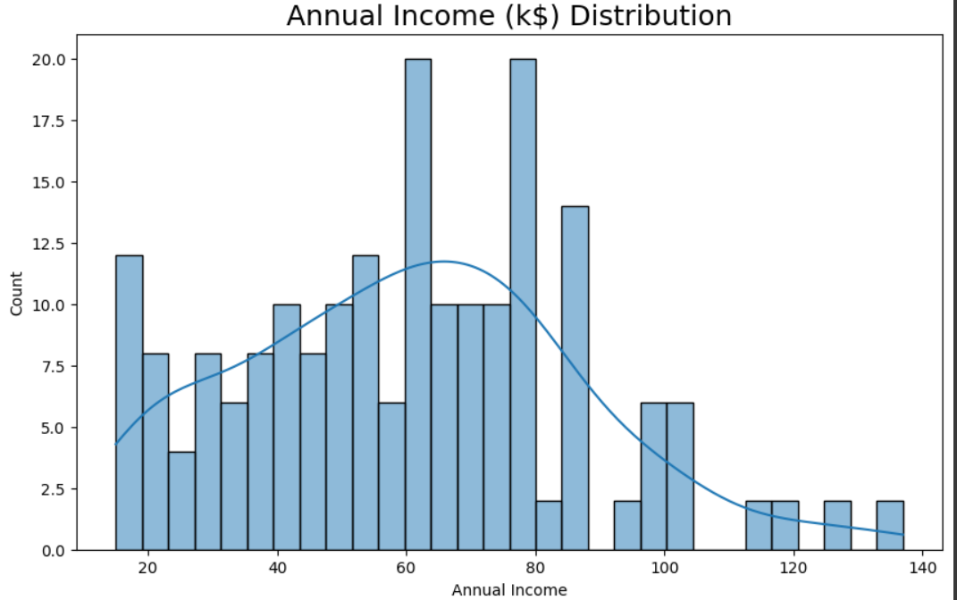
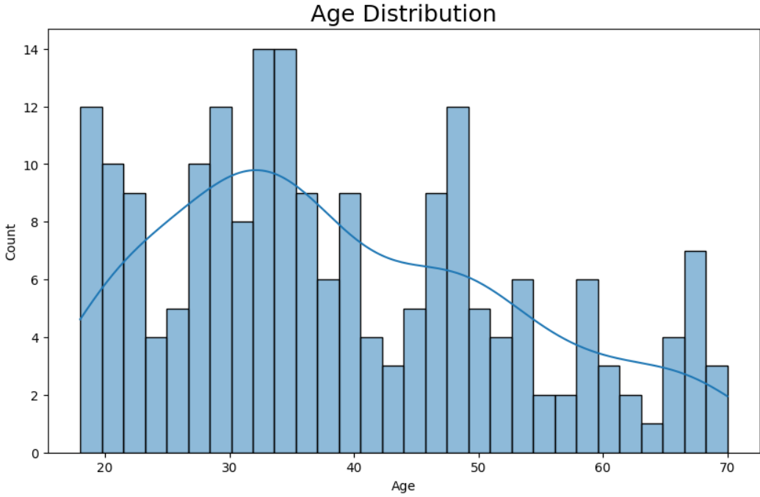
Overview of Data
Notes:
5 variables and 200 observations.
Minimum age is 18. Maximum age is 70. Probably only adults can be member
Minumum annual income is 13k. max income is 137k.
No missing or duplicated values
Both age and income right skewed, meaning more young people and less earning people are members.

Slide 5
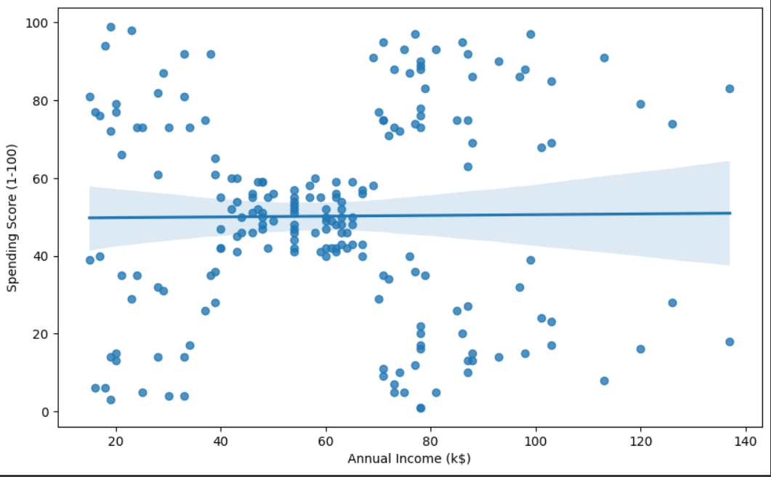
Feature Selection
The Significant score is dependent on Annual Income. Customers earning between 40 and 60 K$ are grouped into the 40 - 60 score bracket.

Slide 6
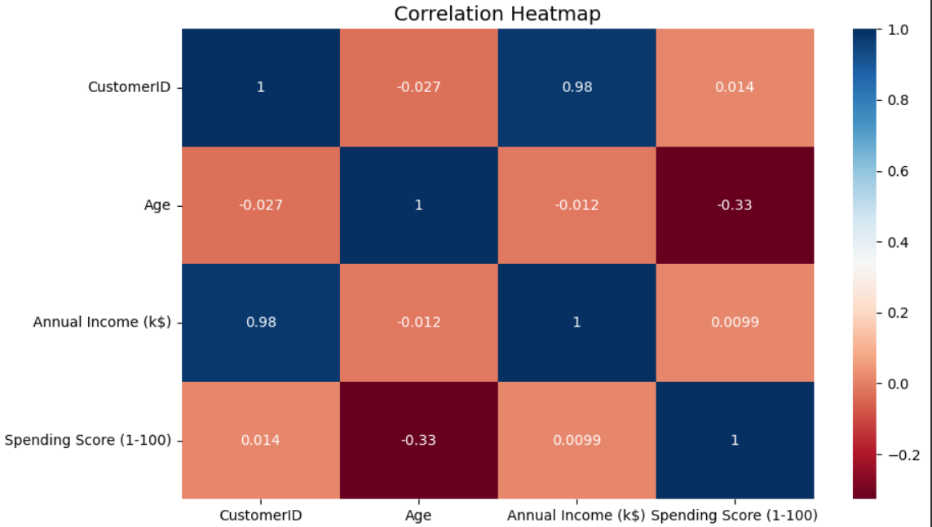
Feature Selection
‘Age’ and ‘Spending score’ have a significant negative correlation. As ‘Age’ increases, the ‘Spending score’ might decrease.

Slide 7
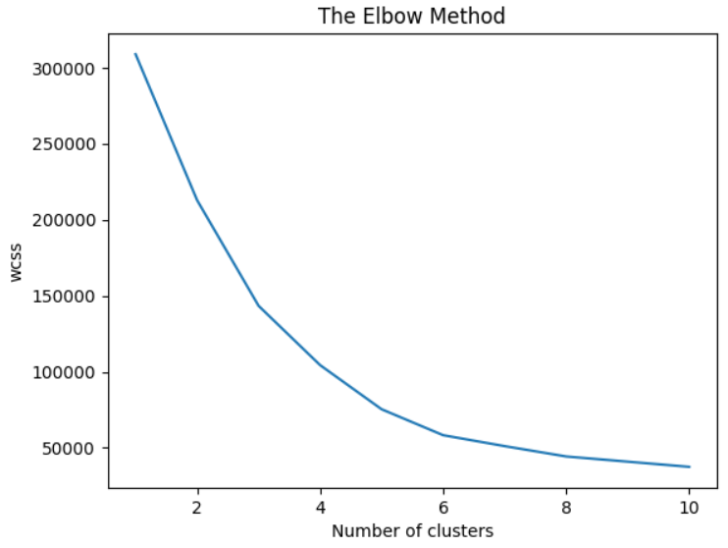
K-means Algorithm
K-means algorithm groups similar data points together to create clusters.
The graph shows the best value for K would be 5. We’ll have 5 clusters.

Slide 8
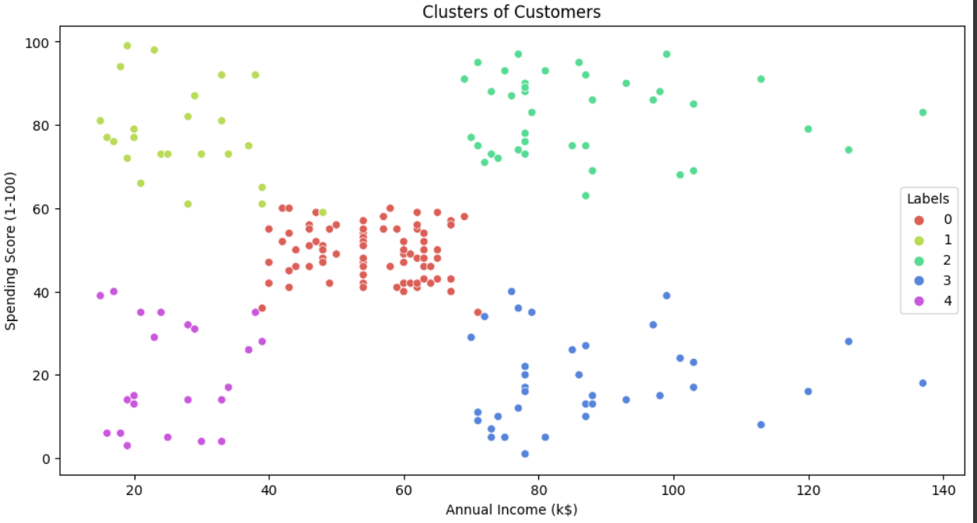
Clusters of Customers

Slide 9
Cluster of Customers
Customers with low annual income and high spending score -> Cluster 1
Customers with high annual income and high spending score -> Cluster 2
Customers with medium annual income and medium spending score -> Cluster 0
Customers with low annual income and low spending score -> Cluster 4
Customers with high annual income and low spending score -> Cluster 3

Slide 10
High Income, High Spending Score
Low Income, High Spending Score
High Income, High Spending Score is the best cluster to target.
There are 39 such customers.
The mean of all such customers are 82.
There are 23 such customers.
The mean of all such customers are 78.

Slide 11
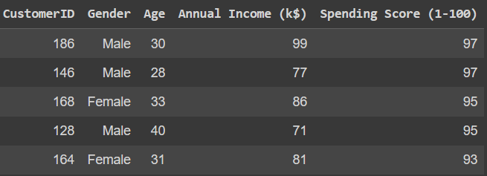
Top 5 Customers to target

Slide 12
Questions ?

